Slide 1
Waste To WoW: Home Waste Management Recommendation System - Recycling or Upcycling
Team 7

Slide 2
Data Engineering

Slide 3
Table of contents
01
02
03
04
05
06
Data Process
Data Collection
Data Pre-Processing
Data Transformation
Data Preparation
Data Statistics

Slide 4
Data Process
Siddharth Solanki

Slide 5
Data Process Steps
Data Collection Plan is created and data samples are drawn from the raw dataset.
Categories of data that will be used for image classification which were identified previously are all stored in a parent folder that will undergo EDA.
The Exploratory Data Plan gives insights on how the data needs to be processed and transformed.
Cleaning and preprocessing steps include: Handling corrupt images, removing images with text, removing duplicates and so on.
Transforming includes normalizing and scaling data, annotation and augmentation.
Lastly data is split for training, validation and testing before final statistics reveal if the data can be used for modeling.

Slide 6
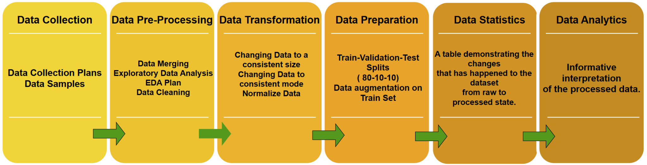
Data Engineering Process Flow Plan

Slide 7
Data Collection
Krishna Sameera Surapaneni

Slide 8
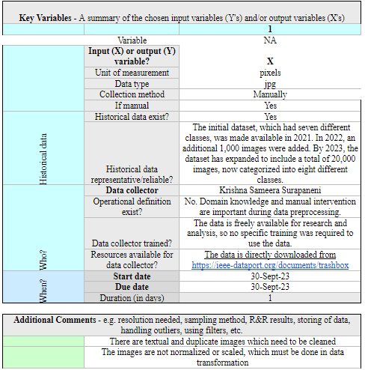
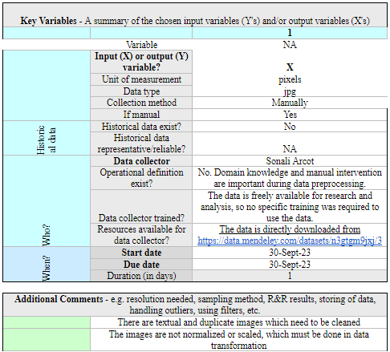
Trashbox and Organic Data

Slide 9
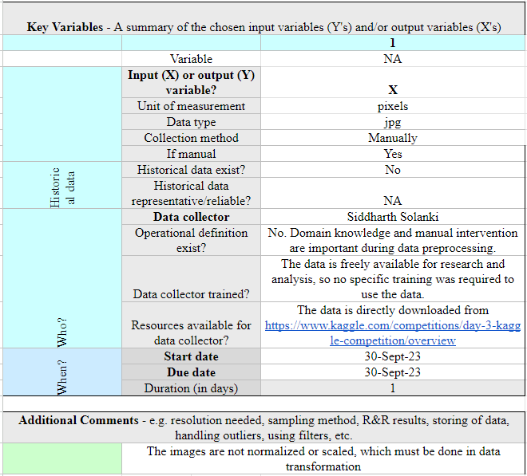
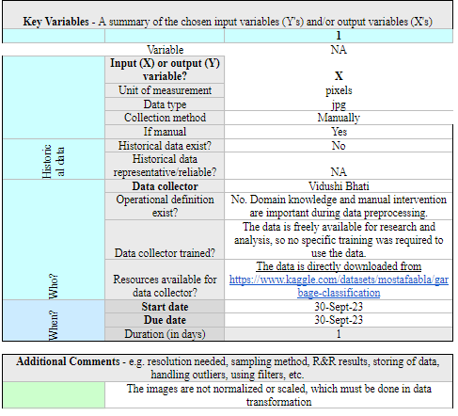
Household and Clothes

Slide 10
Data Pre-Processing
Vidushi Bhati

Slide 11
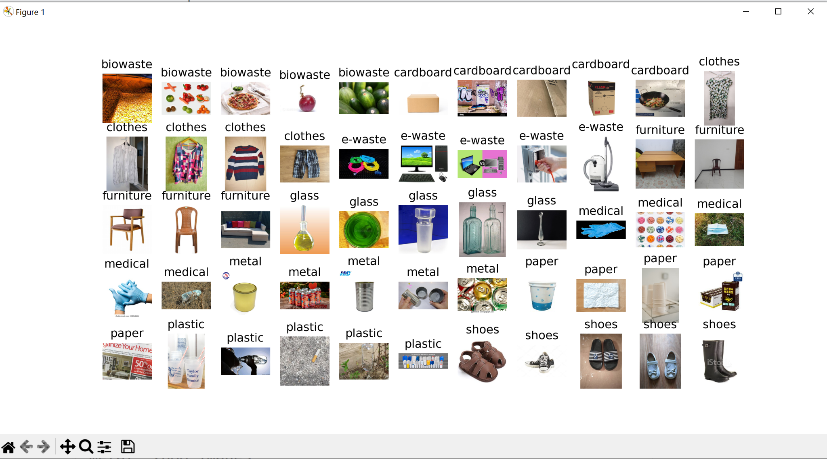
Data Exploration Plan
Data Exploration on the 11 categories of data from different sources are sampled multiple times to determine cleaning steps.

Slide 12
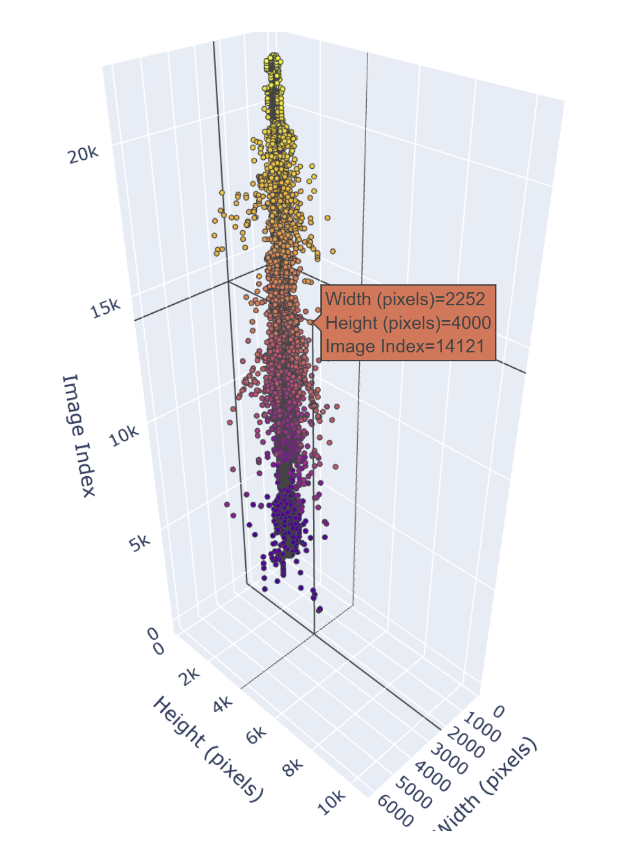
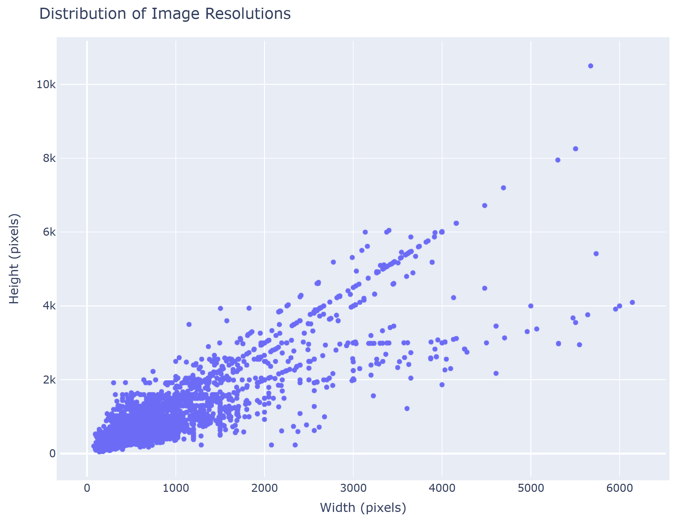
Distribution of Image Dimensions

Slide 13
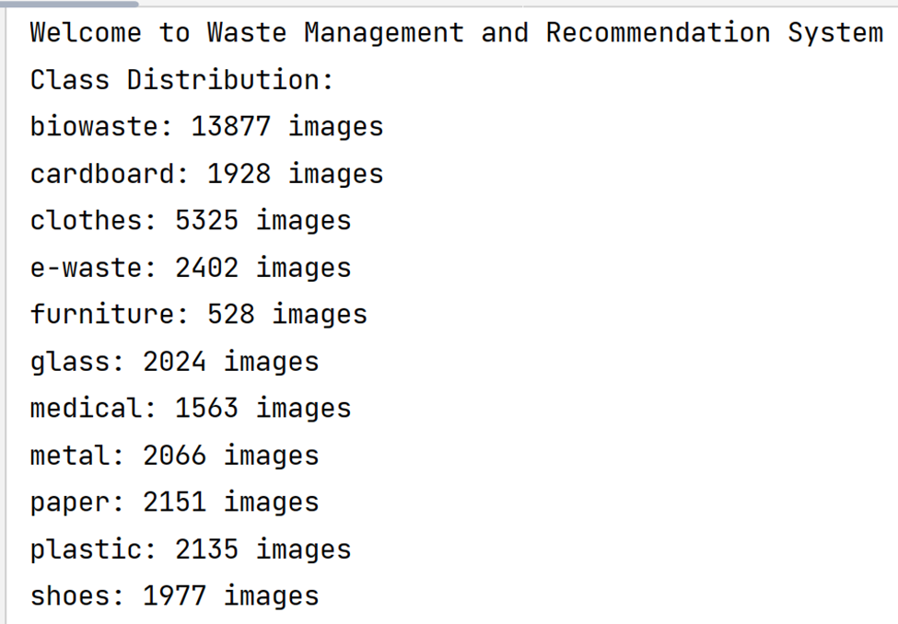
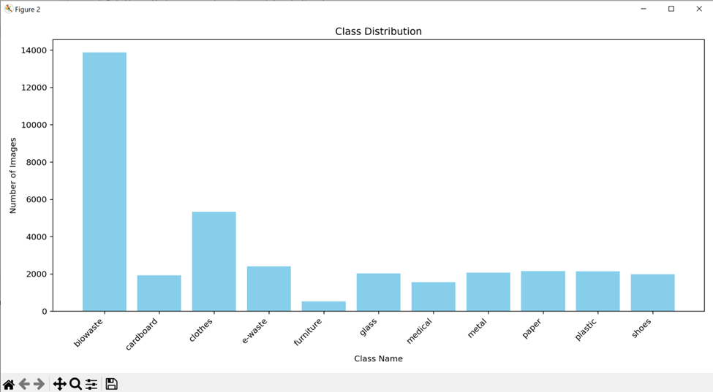
Data Exploration Plan
The class distribution of the data is taken into account in order to decide what the final distribution of the data should look like.

Slide 14
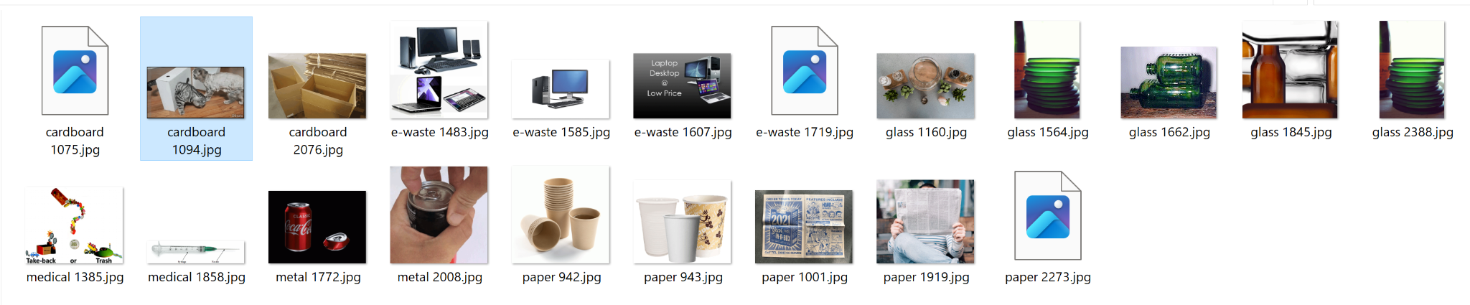
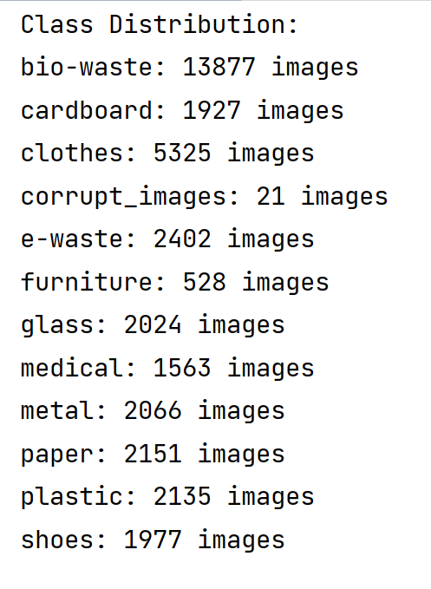
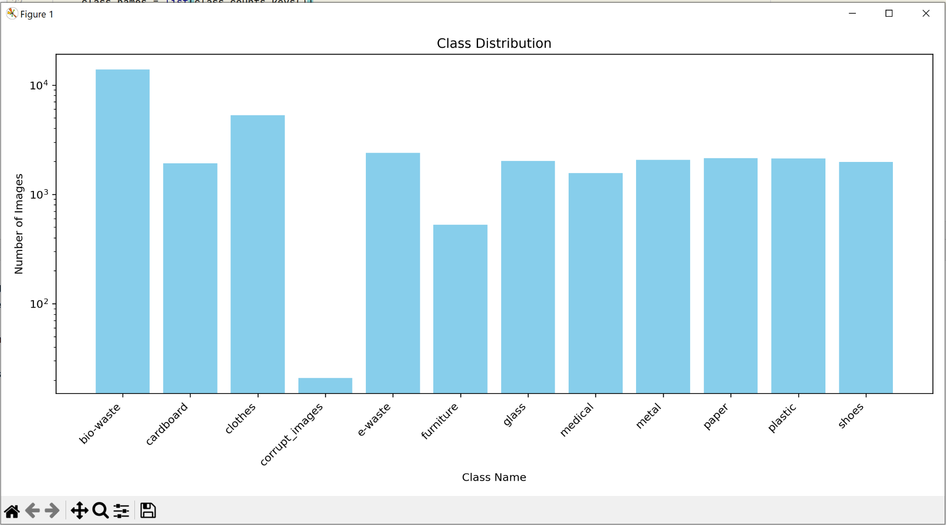
Data Pre-Processing
Removal of Corrupt files

Slide 15
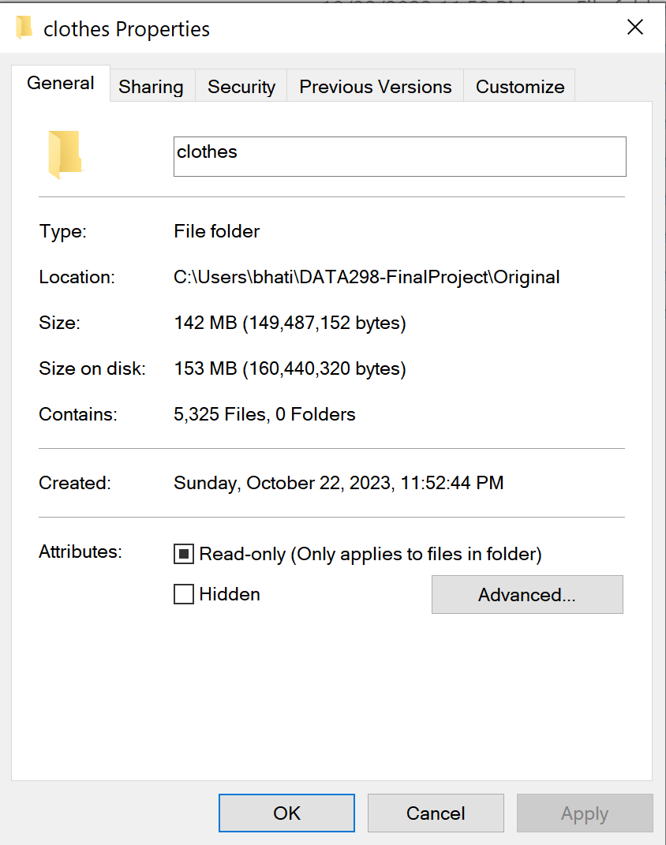
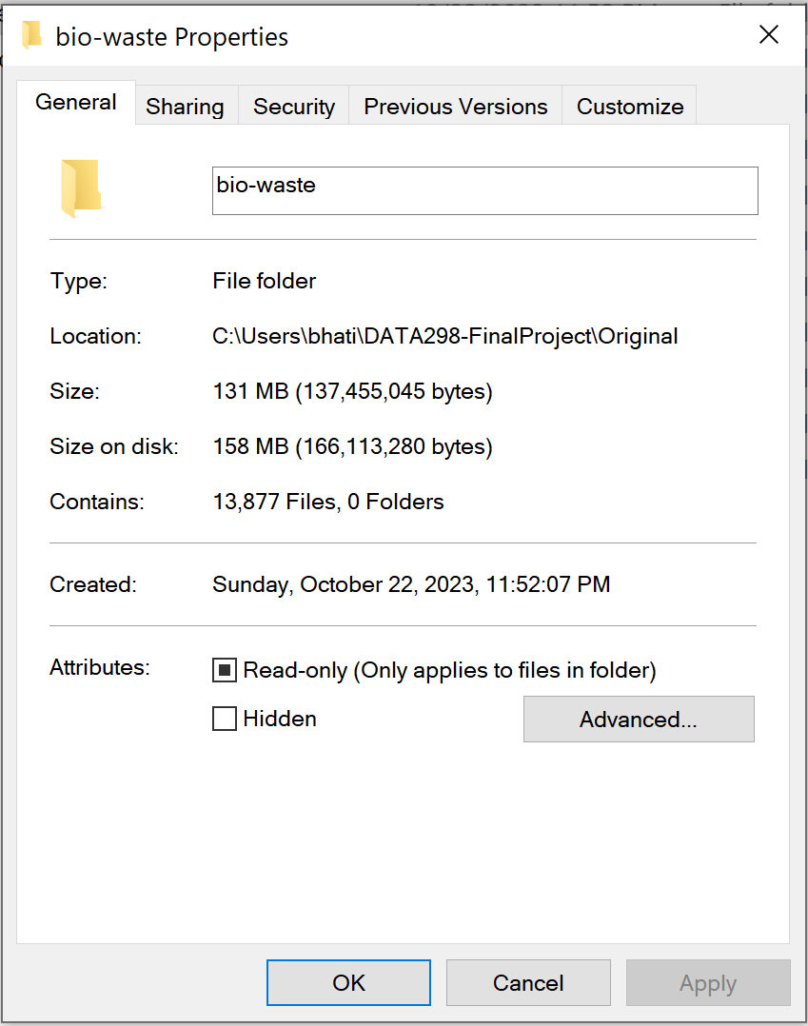
Data Pre-Processing
Sample 2500 images

Slide 16
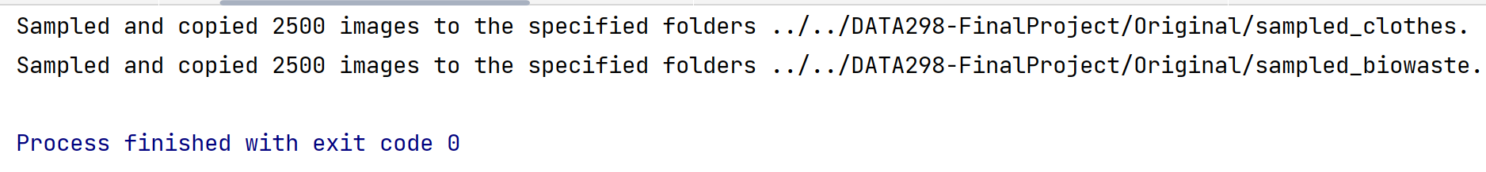
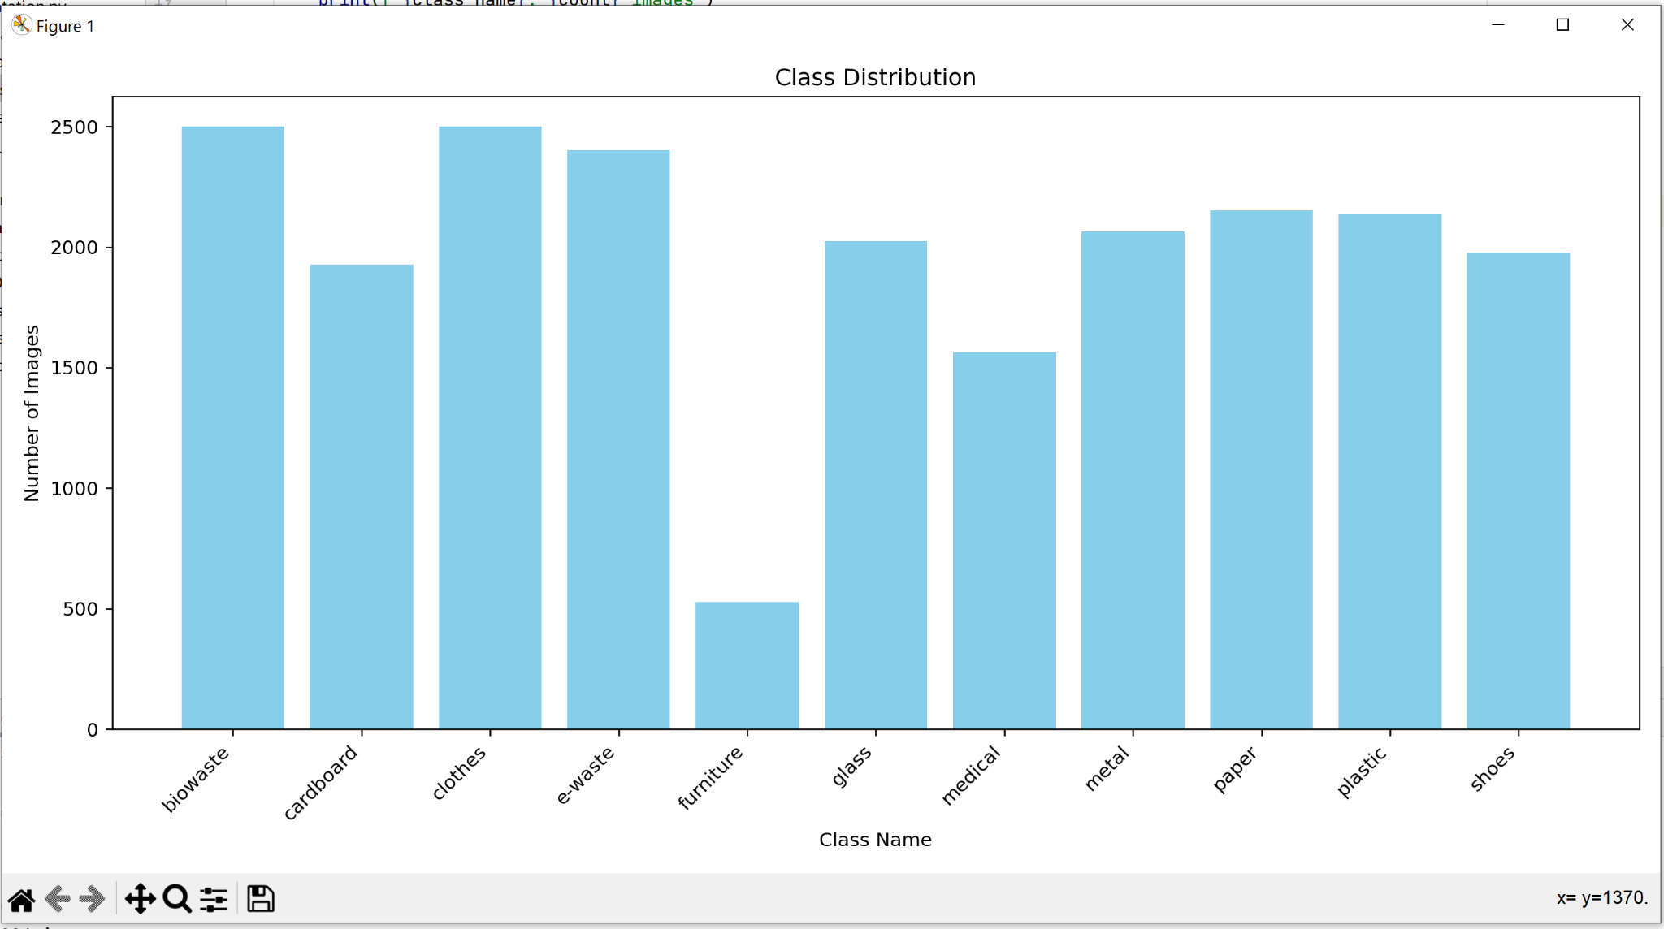
Data Pre-Processing
Sample 2500 images

Slide 17
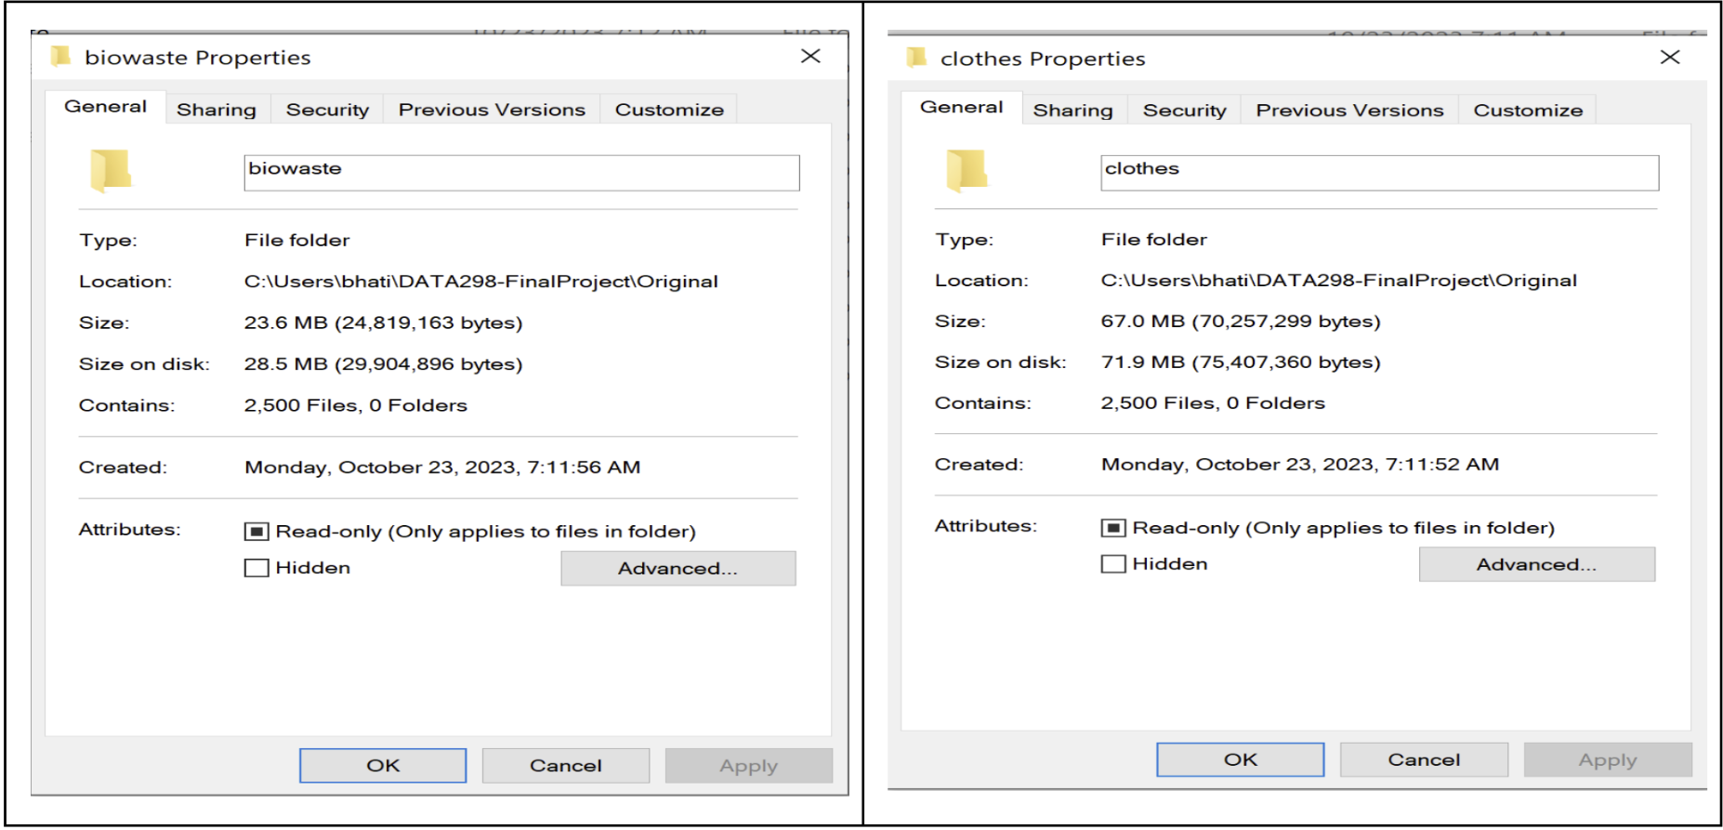
Change in the Size after UnderSampling

Slide 18

Data Pre-Processing
Removal of Textual Content in Files
Pytesseract package and it’s libraries are used to detect images with text.
Images identified in biowaste category are unusable for classification and were thus deleted.
Samples

Slide 19
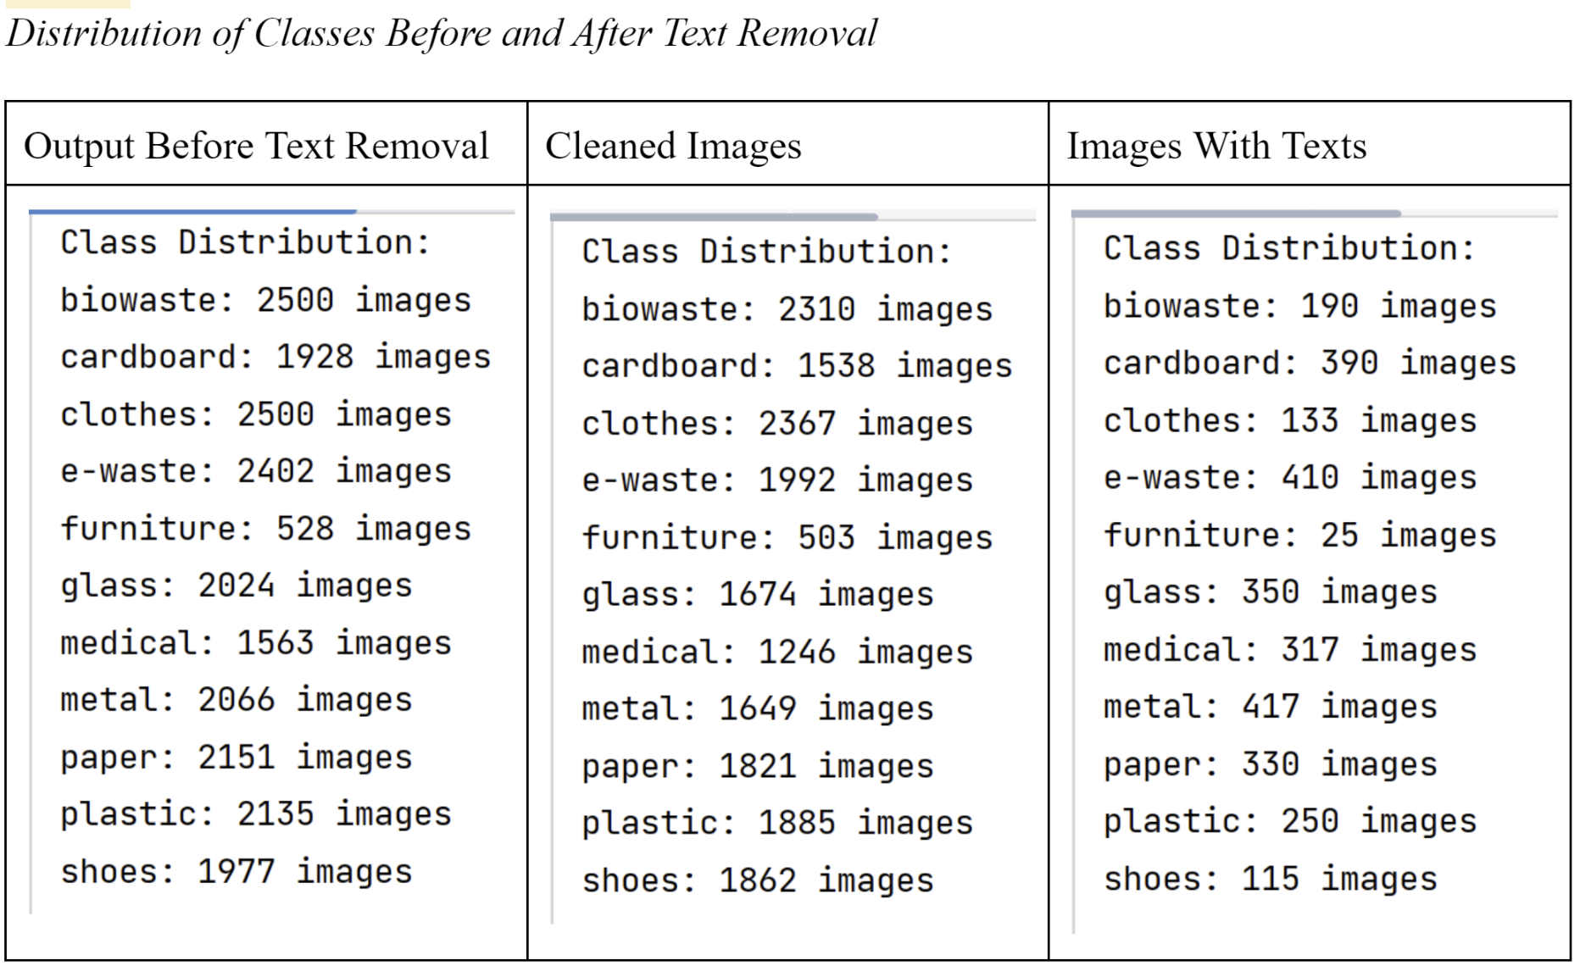
Distribution of classes before and after removal of images with text

Slide 20
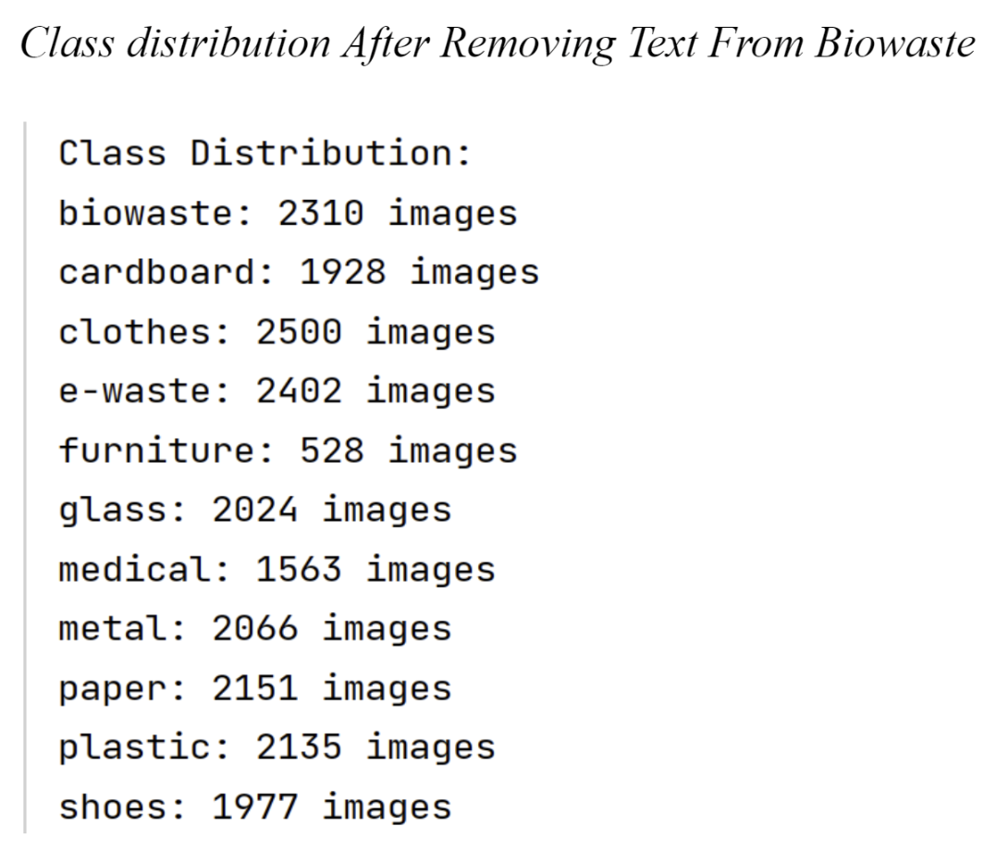
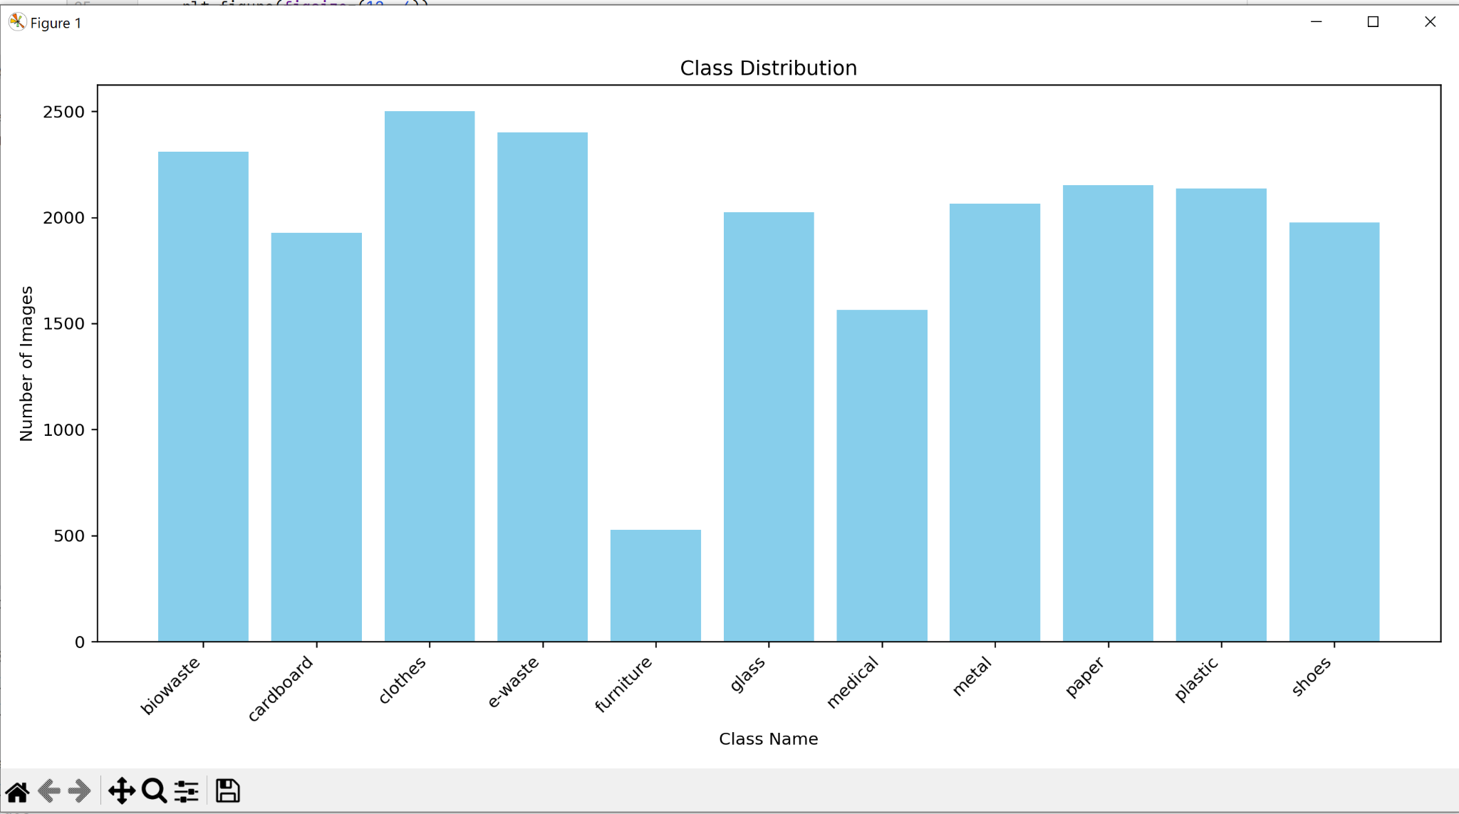

Slide 21
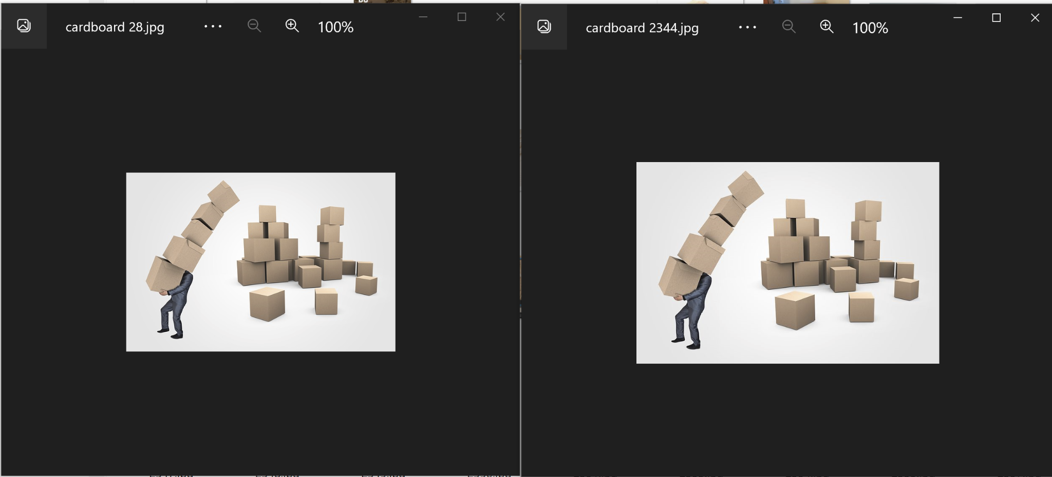
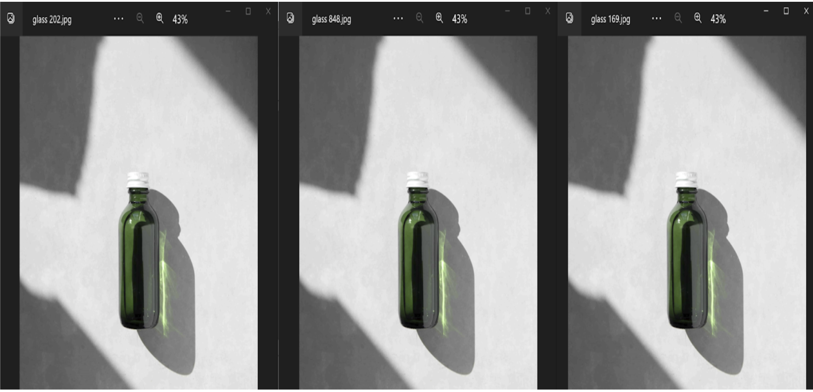
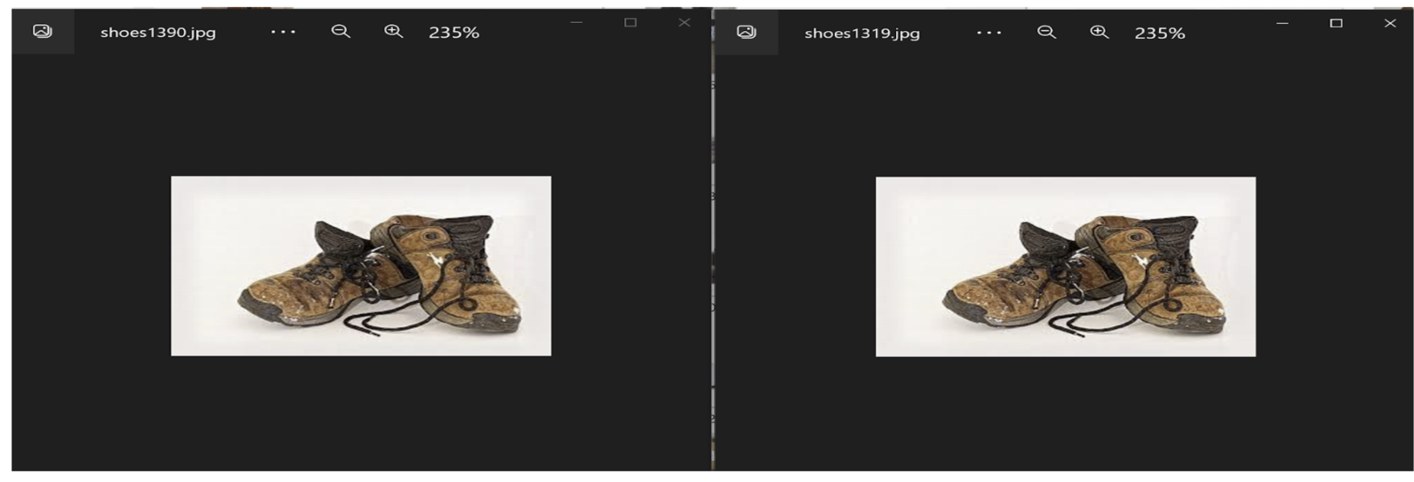
Data Pre-Processing
Removal of Duplicates Images

Slide 22
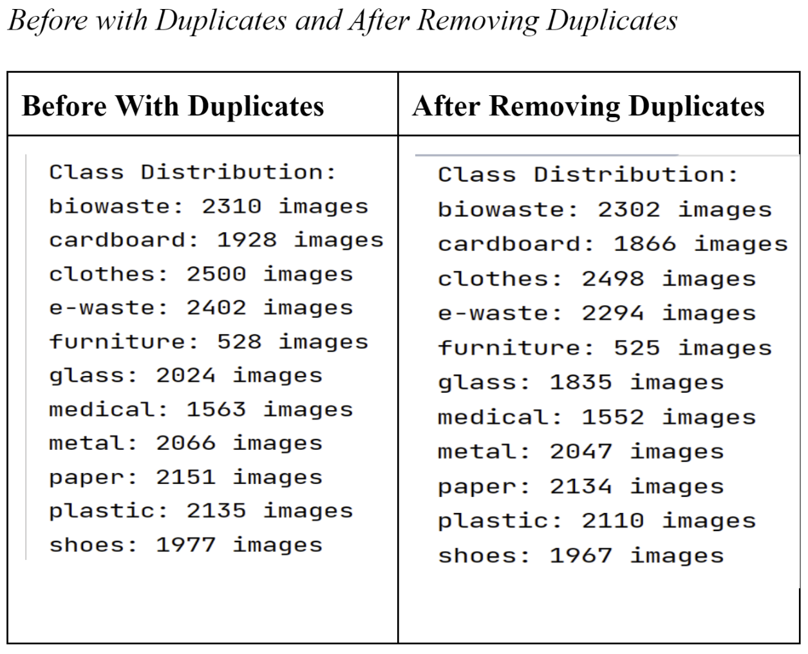

Slide 23
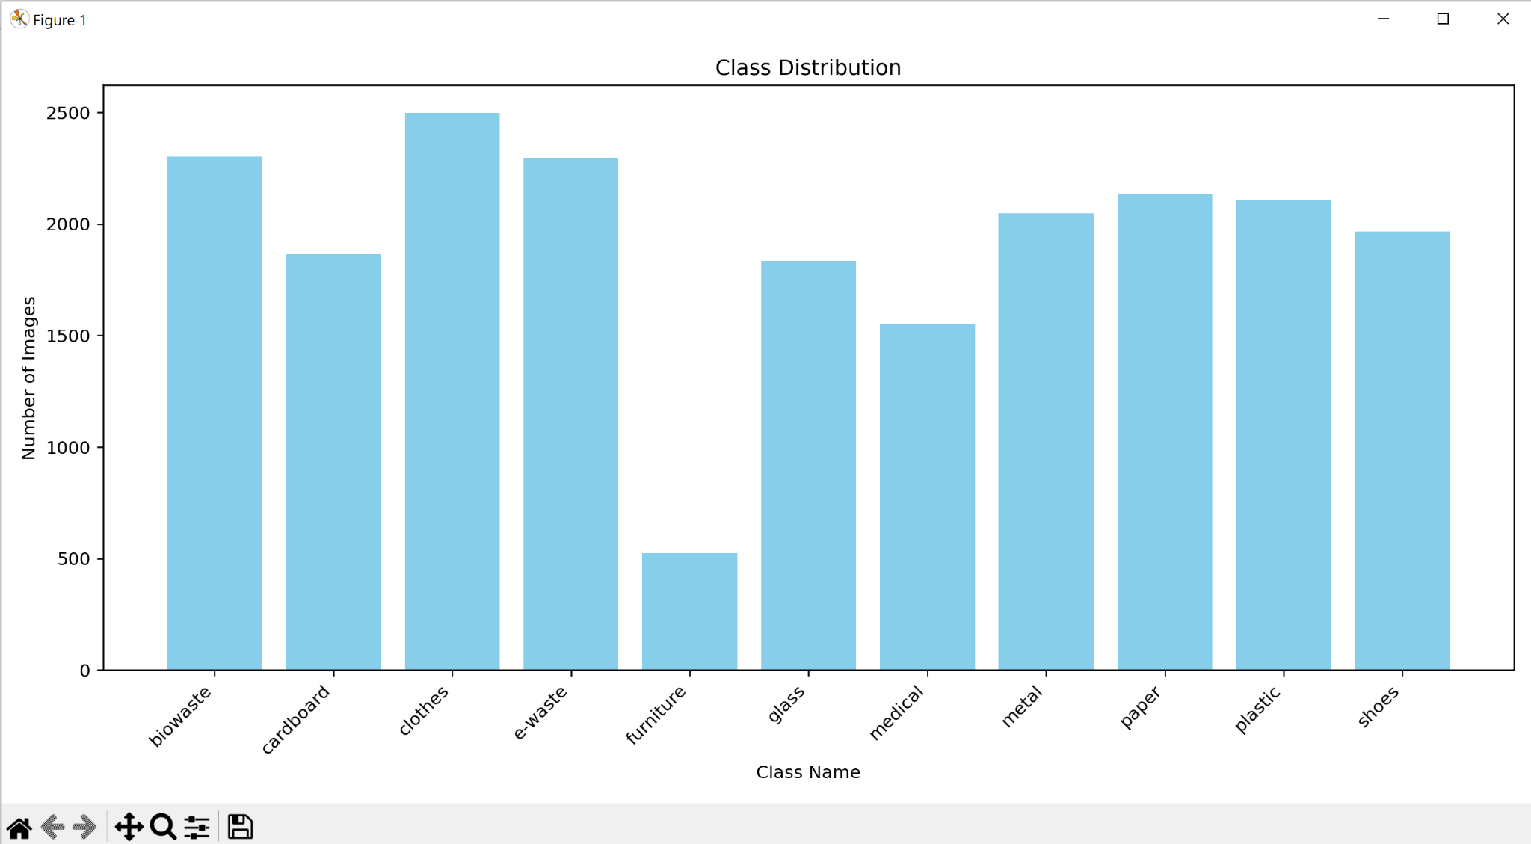

Slide 24
Data Transformation
Sonali Arcot

Slide 25
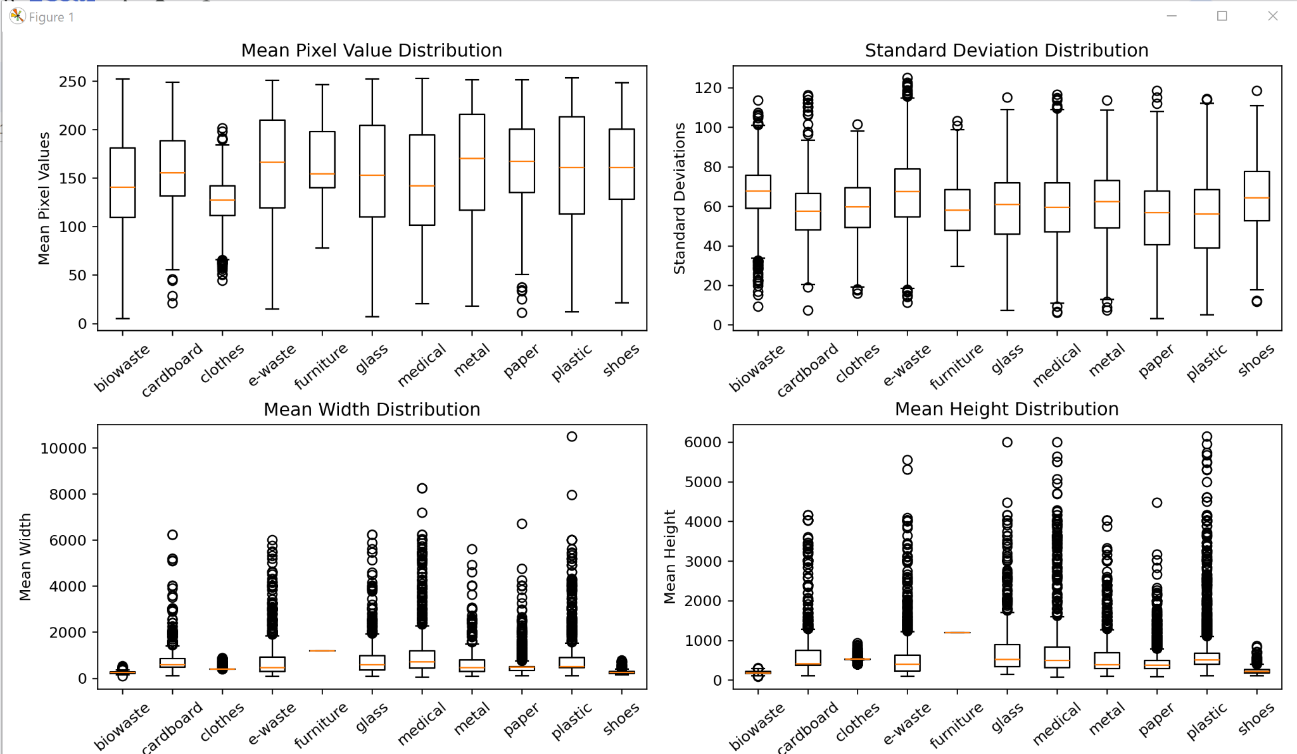
Data Transformation
Class Statistics Before Normalization

Slide 26
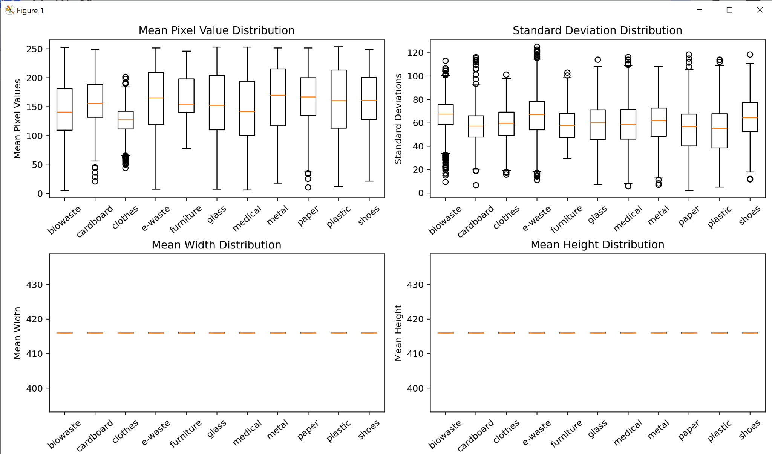
Data Transformation
Class Statistics After Normalization

Slide 27
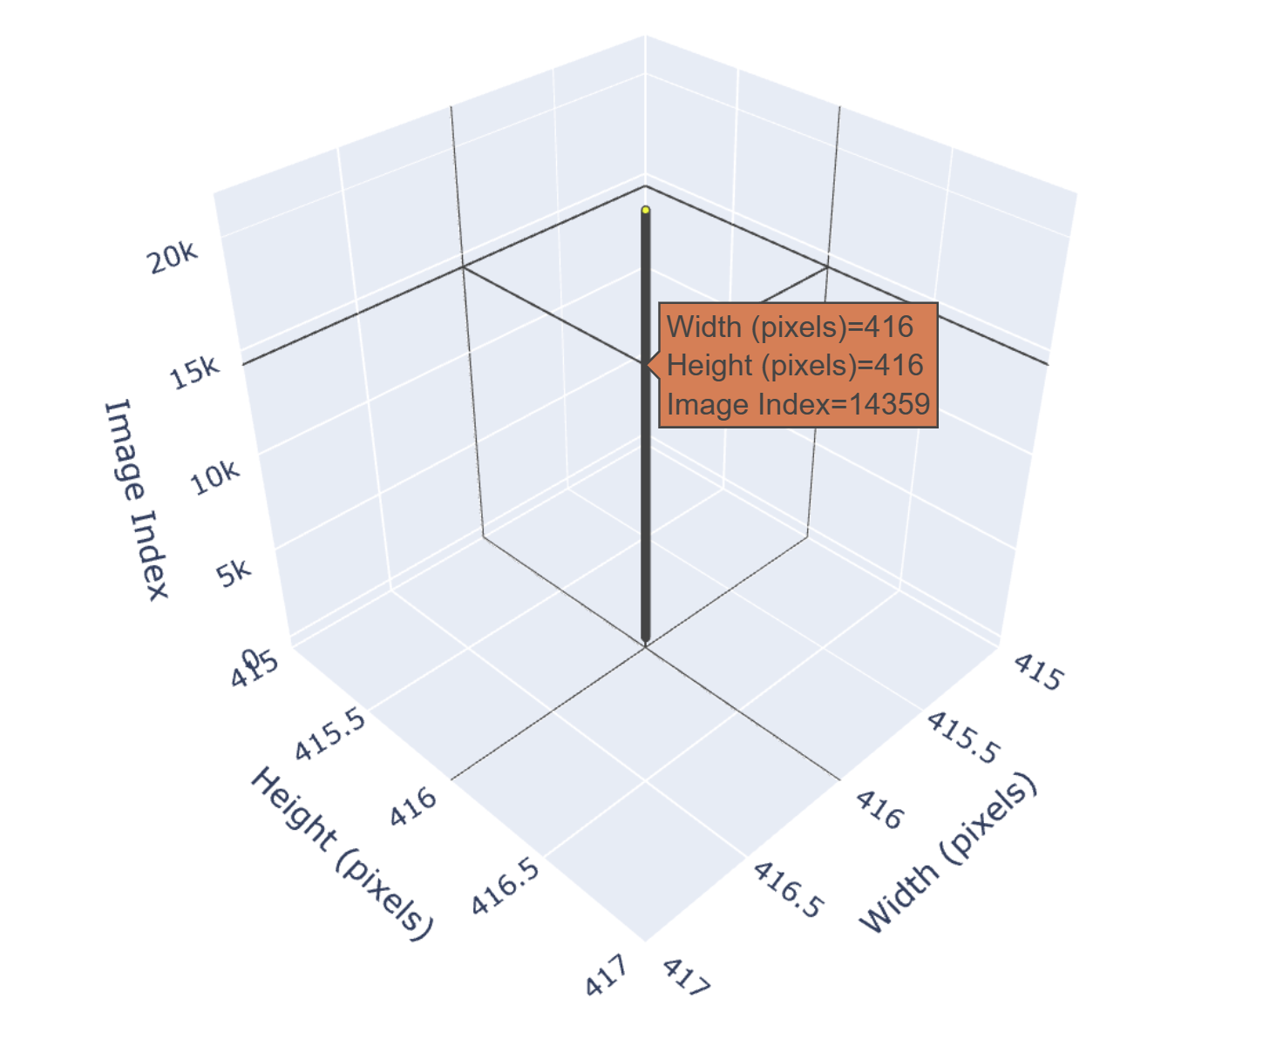
Data Transformation
3D Visualization After Resizing

Slide 28
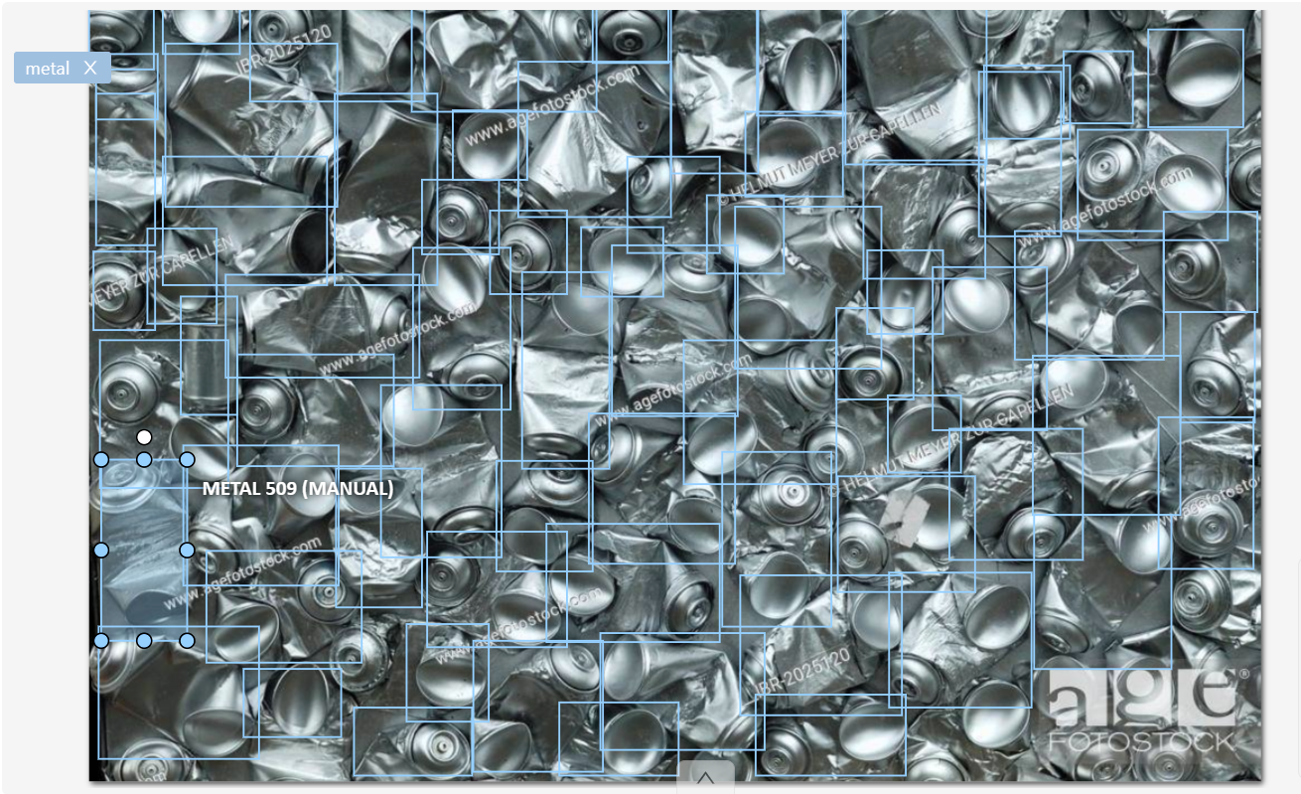
Data Transformation
Manual Annotations using CVAT

Slide 29
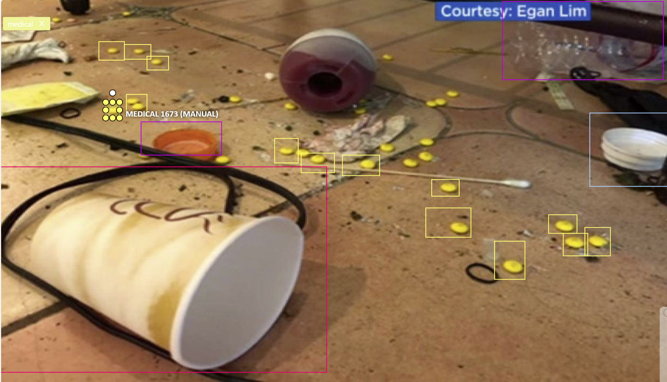
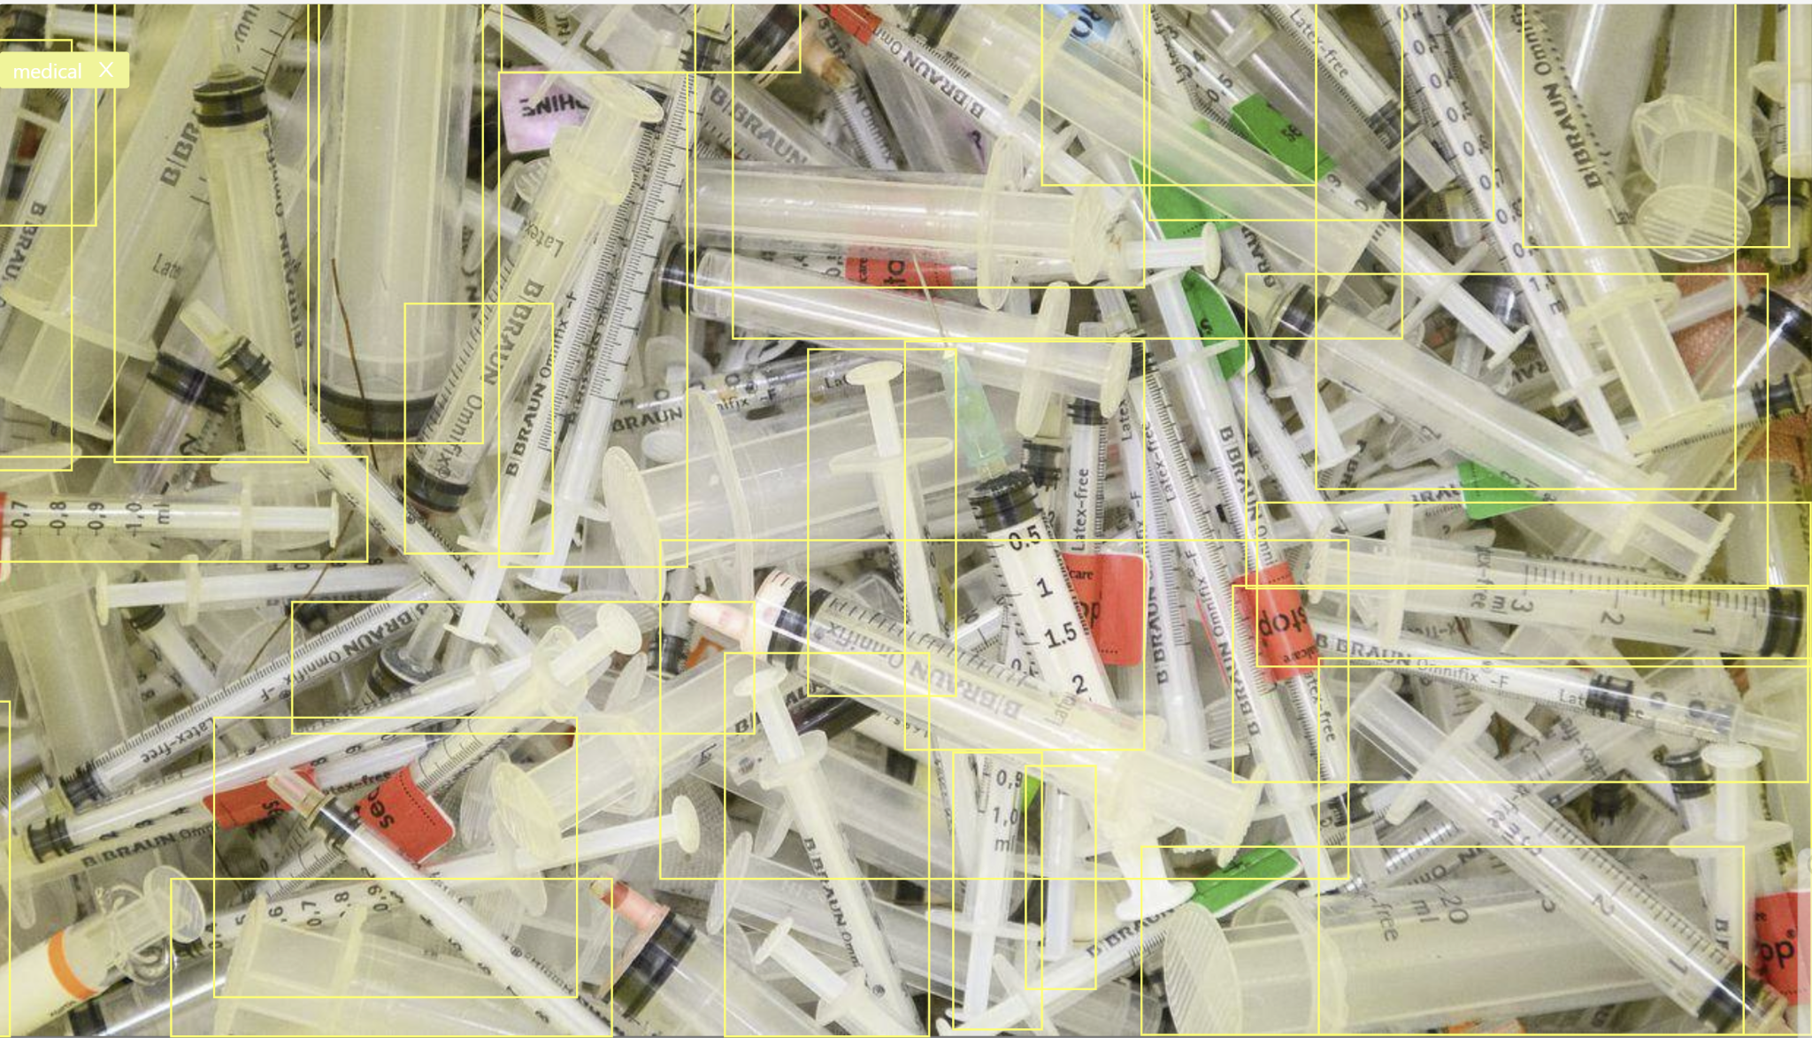
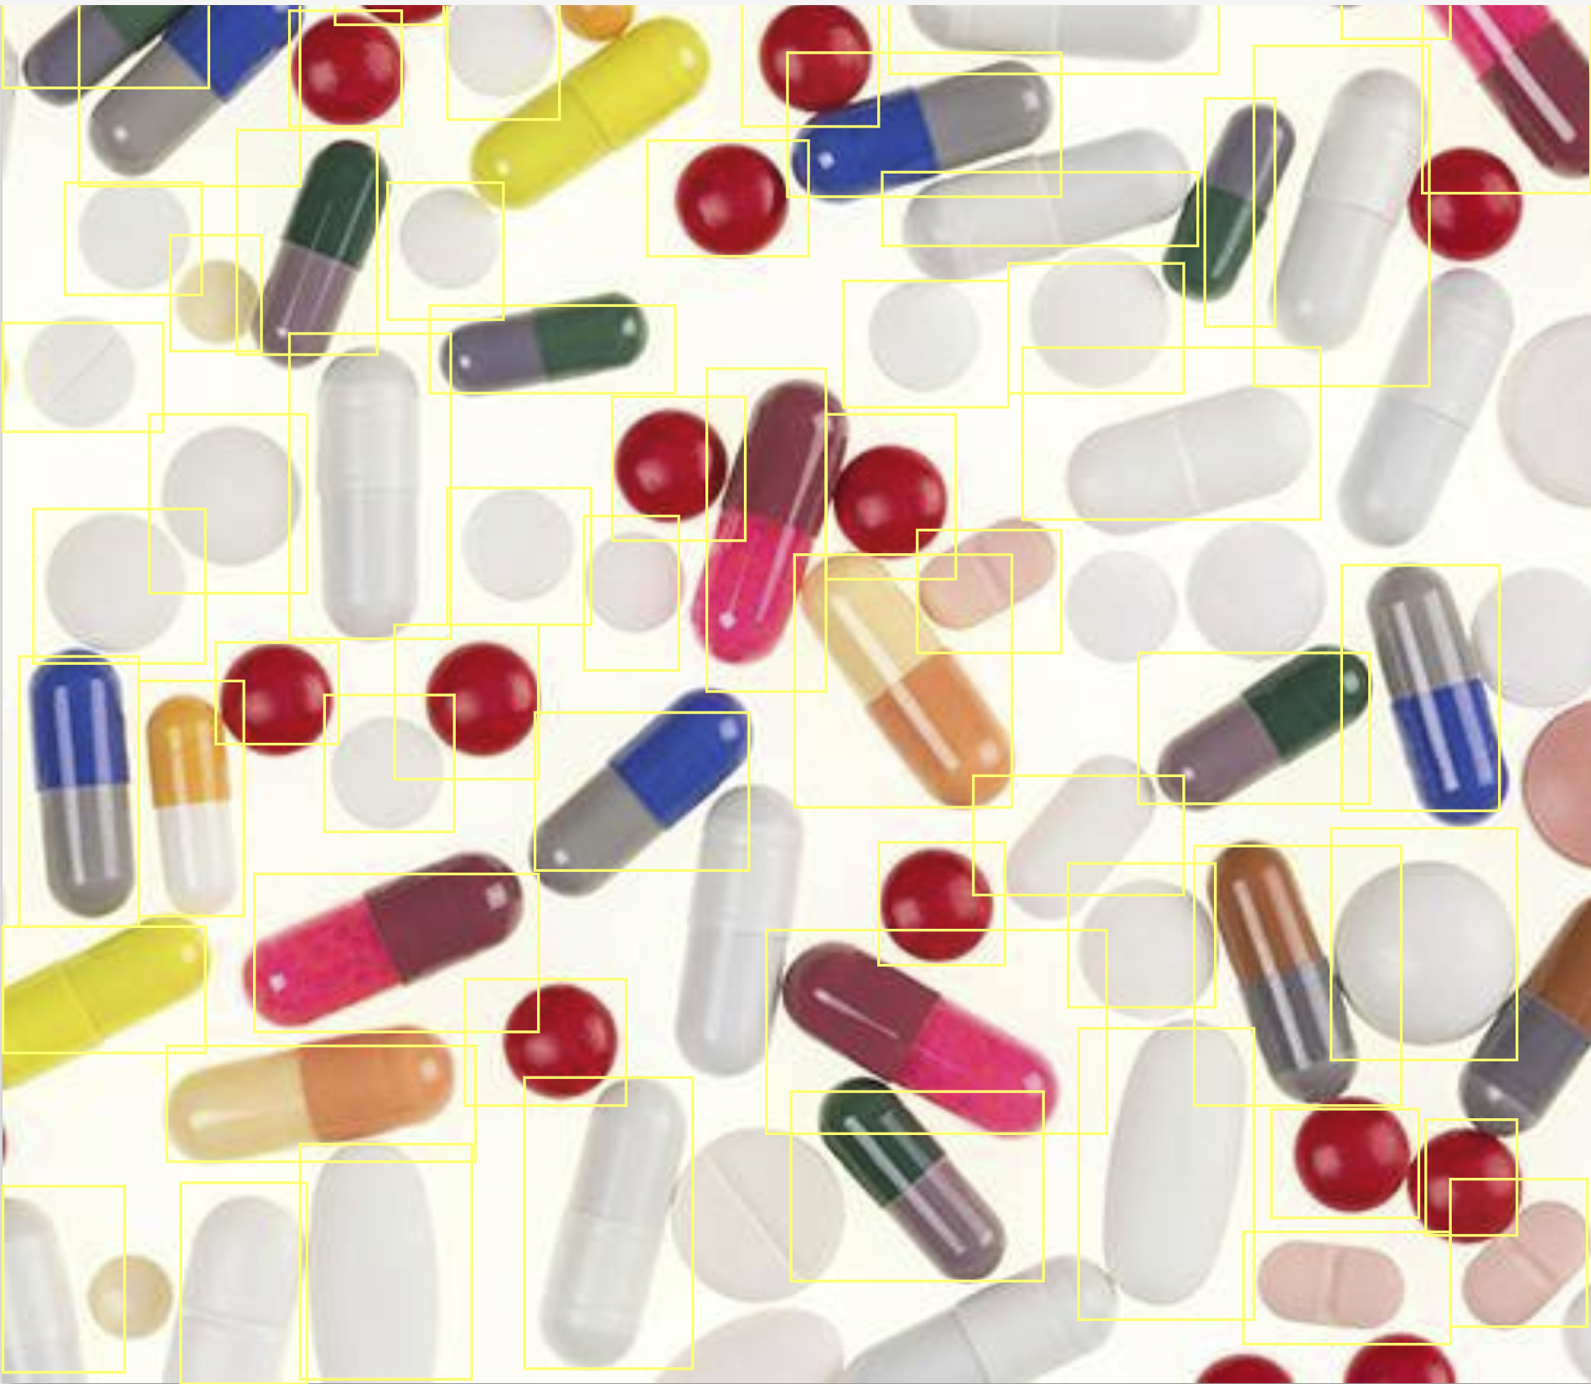
Tag Annotation and Bounding Boxes

Slide 30
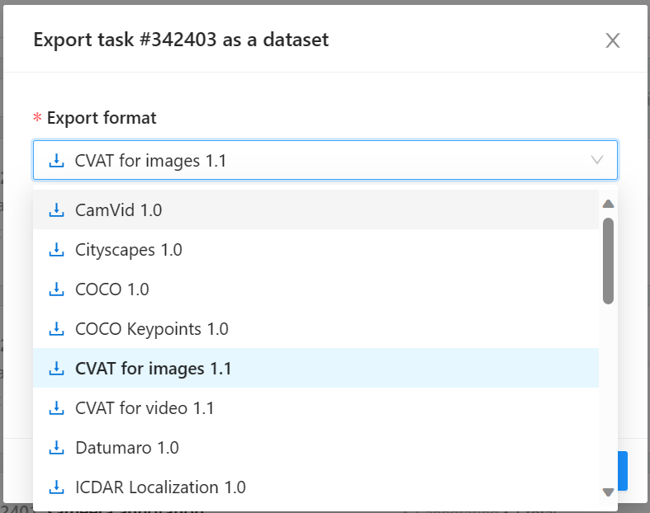
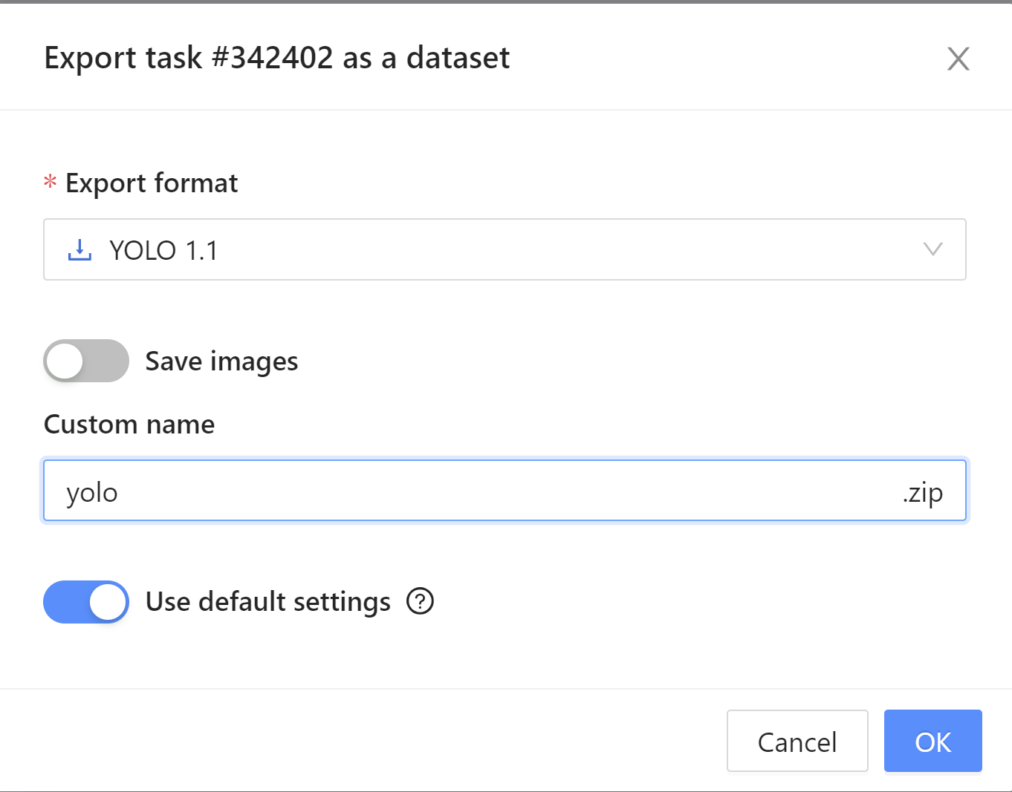
Exporting Formats

Slide 31
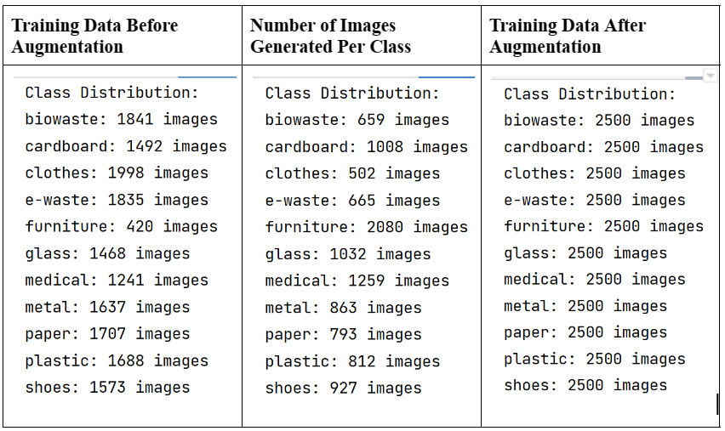
Data Transformation
Class Distribution Before and After Augmentation

Slide 32
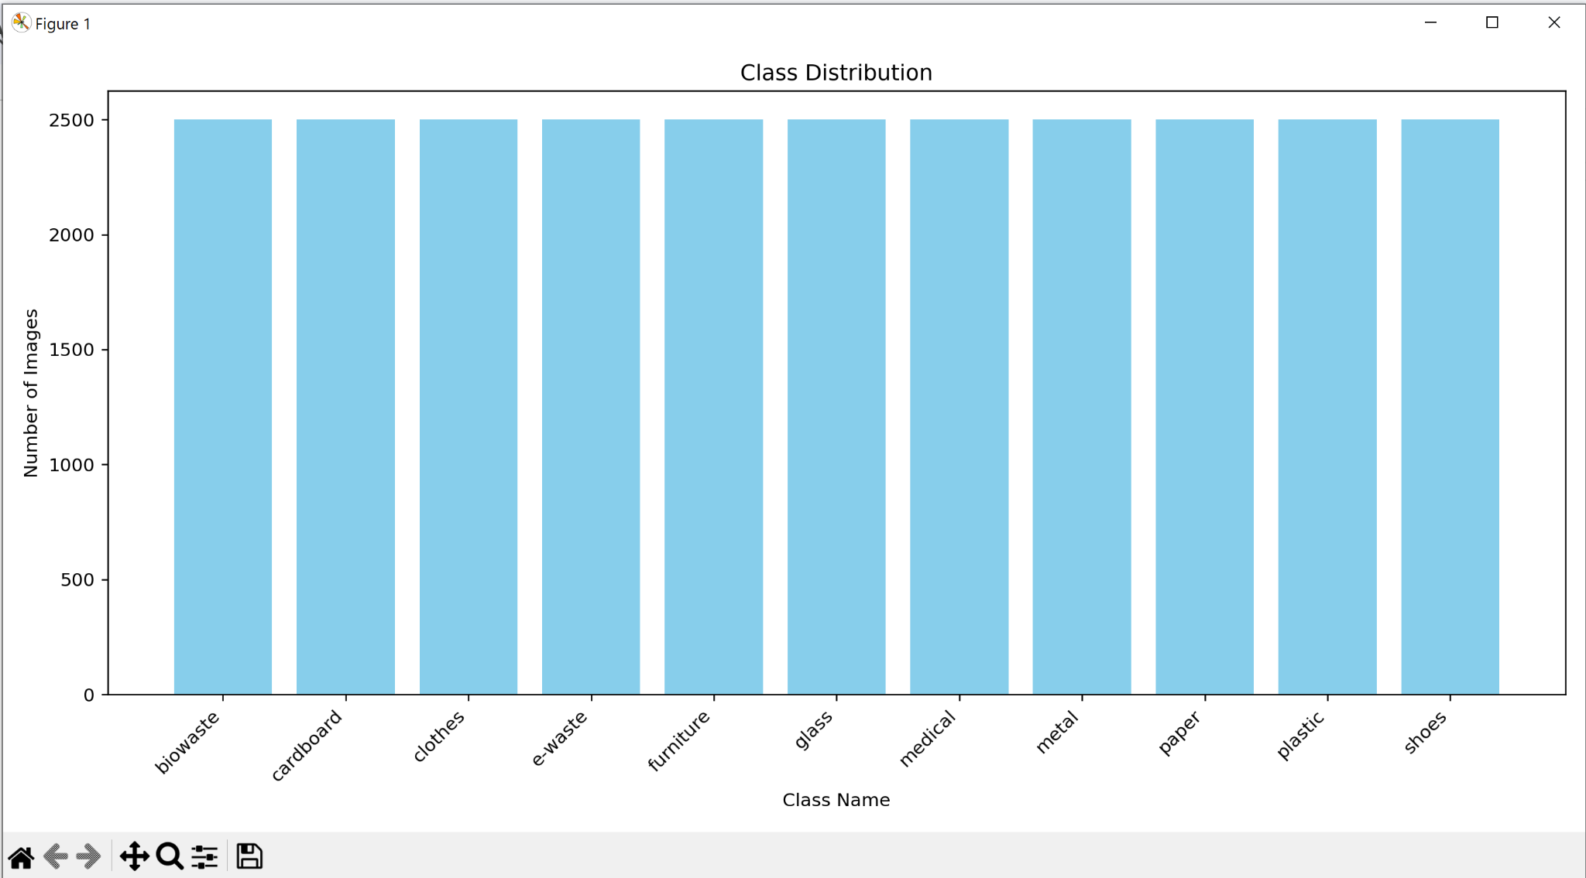
Data Transformation
Class Distribution After Augmentation

Slide 33
Data Preparation
Krishna Sameera Surapaneni

Slide 34
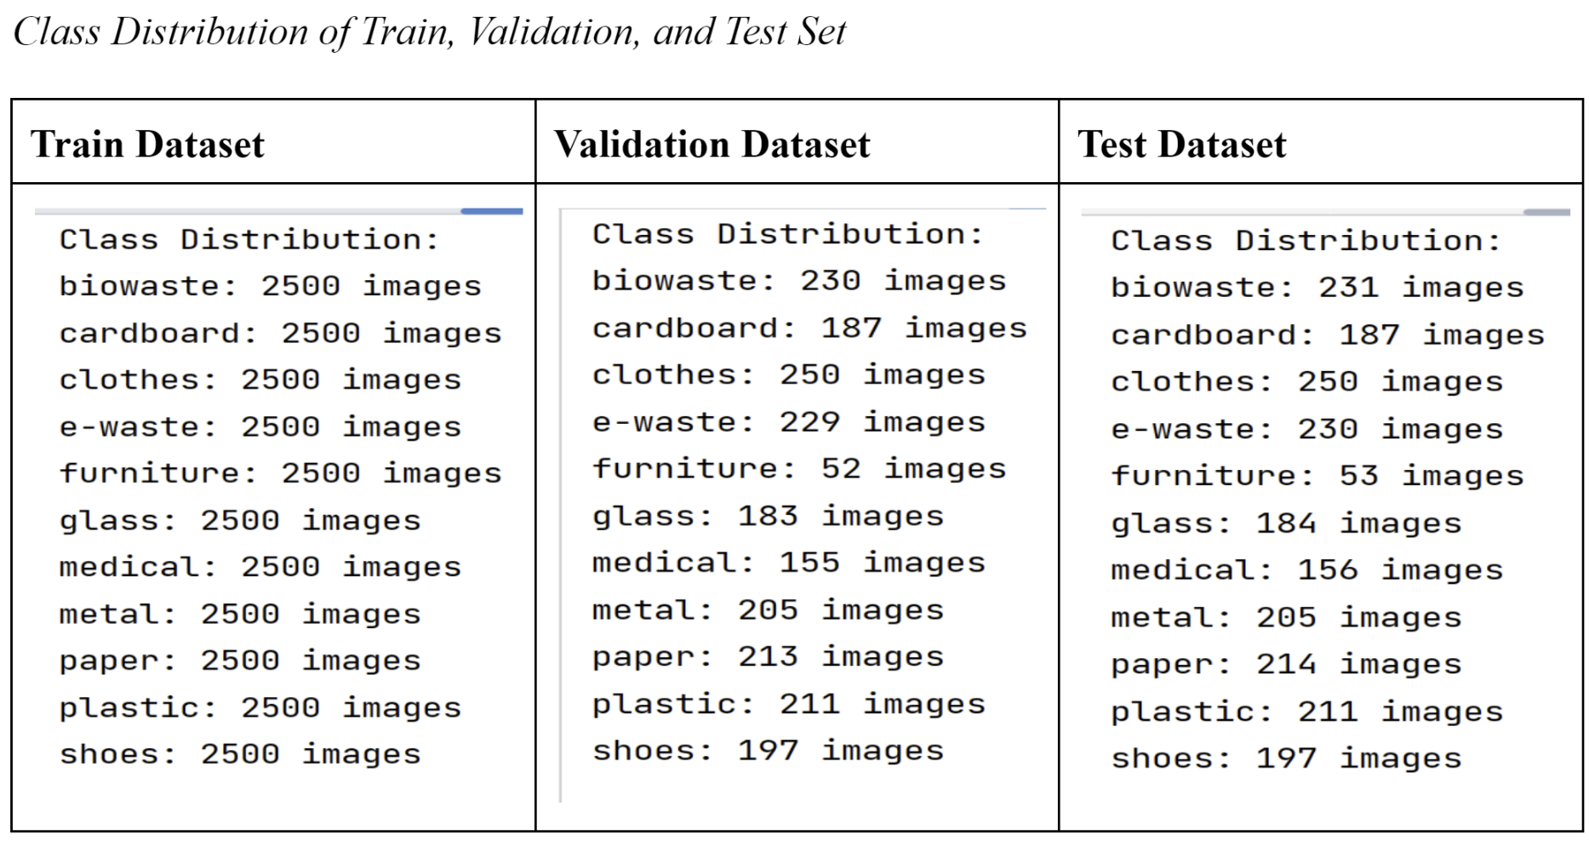
Train, Validation, and Test Design
Train - 80%
Validation - 10%
Test- 10%

Slide 35
Data Statistics
Sonali Arcot

Slide 36
Data Statistics
Stage | Methods | Statistics of Dataset and Classes
Raw data |  | Garbage Classification Dataset: 15,515 Files, 238 MB Trashbox Dataset: 28,564 Files, 4.24 GB Waste Classification Dataset: 24,708 Files, 210 MB Furniture Dataset: 694 Files, 53.5 MB
Pre-processing data | Corrupt Images handled Undersampling of classes with more than 2500 images Images with text handled (biowaste class) Duplicate images handled | Class Distribution: biowaste: 2302 images cardboard: 1866 images clothes: 2498 images e-waste: 2294 images furniture: 525 images | glass: 1835 images medical: 1522 images metal: 2047 images paper: 2134 images plastic: 2110 images shoes: 1967 images

Slide 37
Data Statistics
Stage | Methods | Statistics of Dataset and Classes
Data Transformation | Normalizing and Scaling Data Annotation Data Augmentation | Class Distribution of Augmented Training: biowaste: 2500 images cardboard: 2500 images clothes: 2500 images e-waste: 2500 images furniture: 2500 images | glass: 2500 images medical: 2500 images metal: 2500 images paper: 2500 images plastic: 2500 images shoes: 2500 images
Data Preparation | For Training | Total number of images for training: 27500 images Total number of images for validation: 2118 images Total number of images for testing: 2112 images

Slide 38
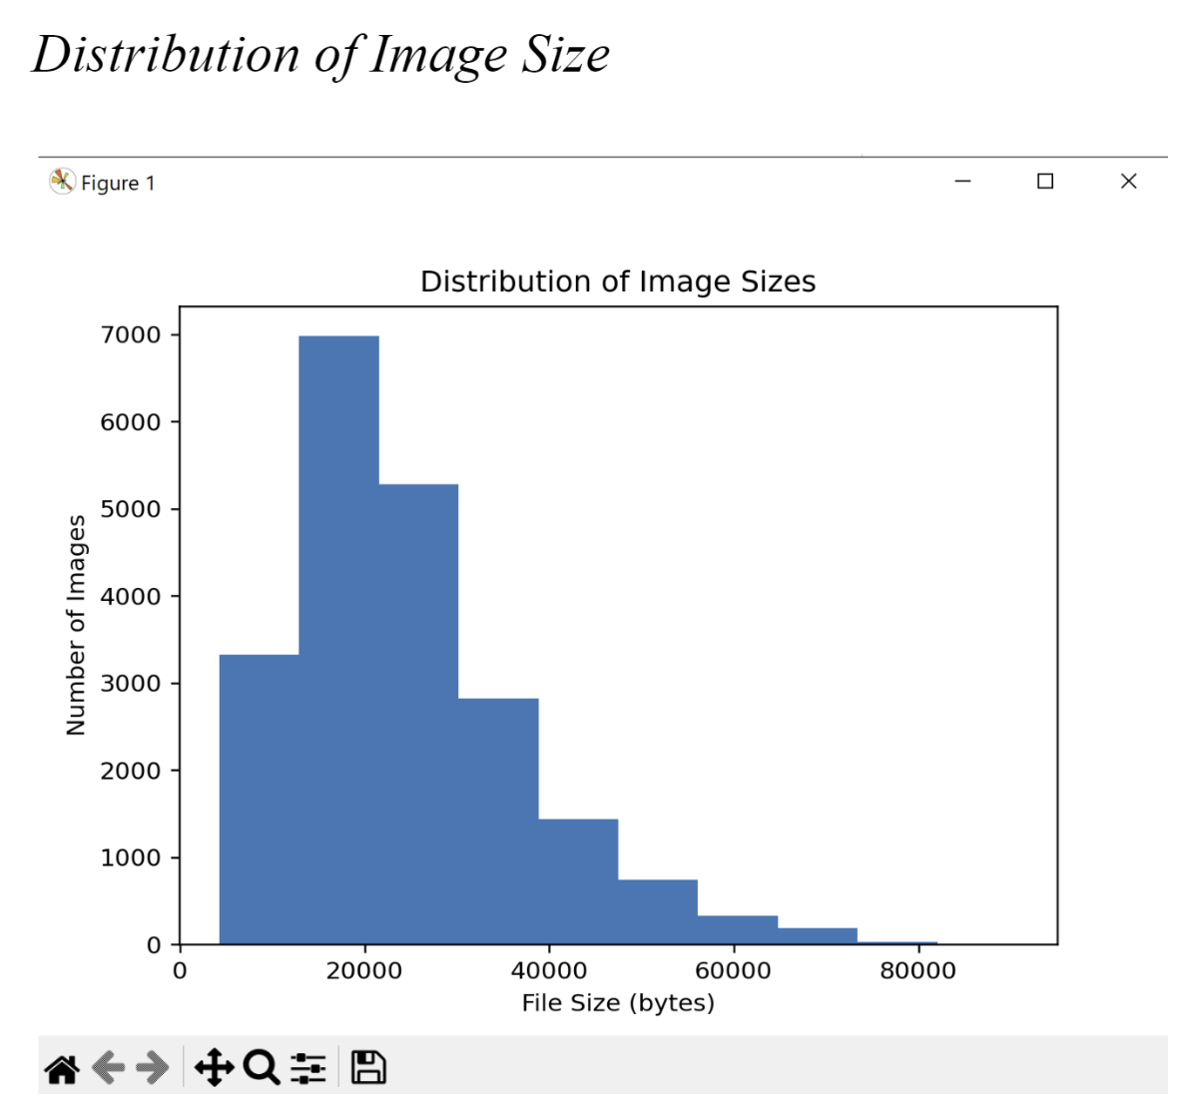
Most images are 15000 to 25000 bytes in size
Few images are larger in size
It may be due to higher resolution of images

Slide 39
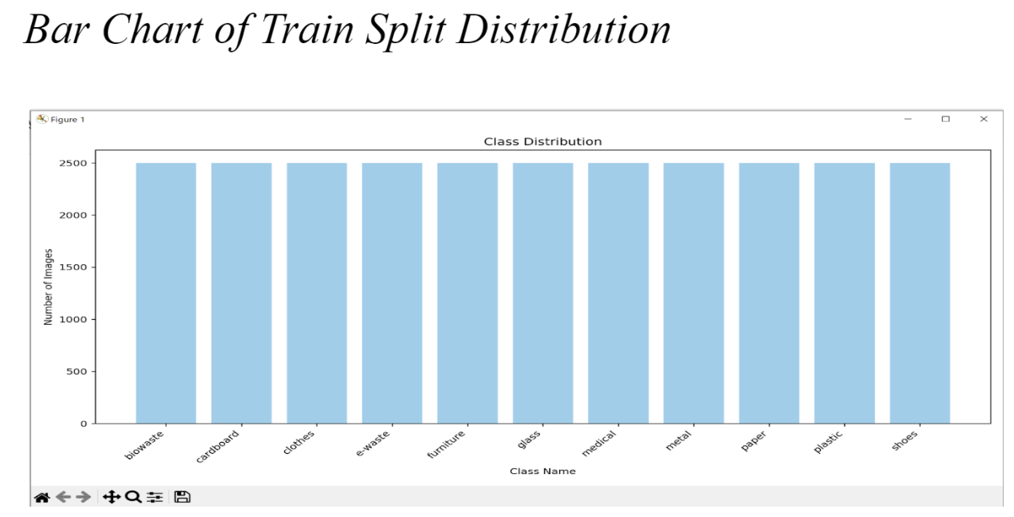
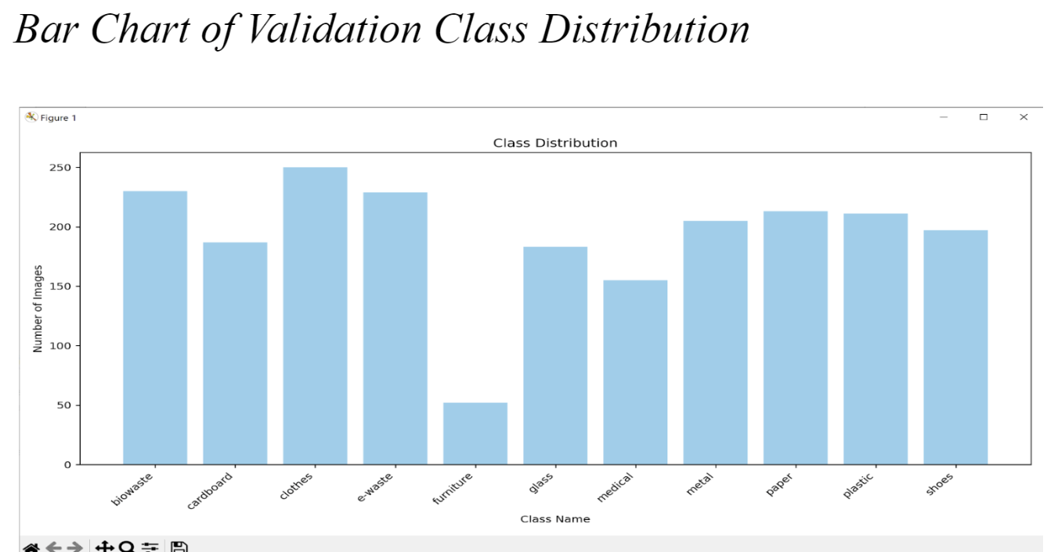
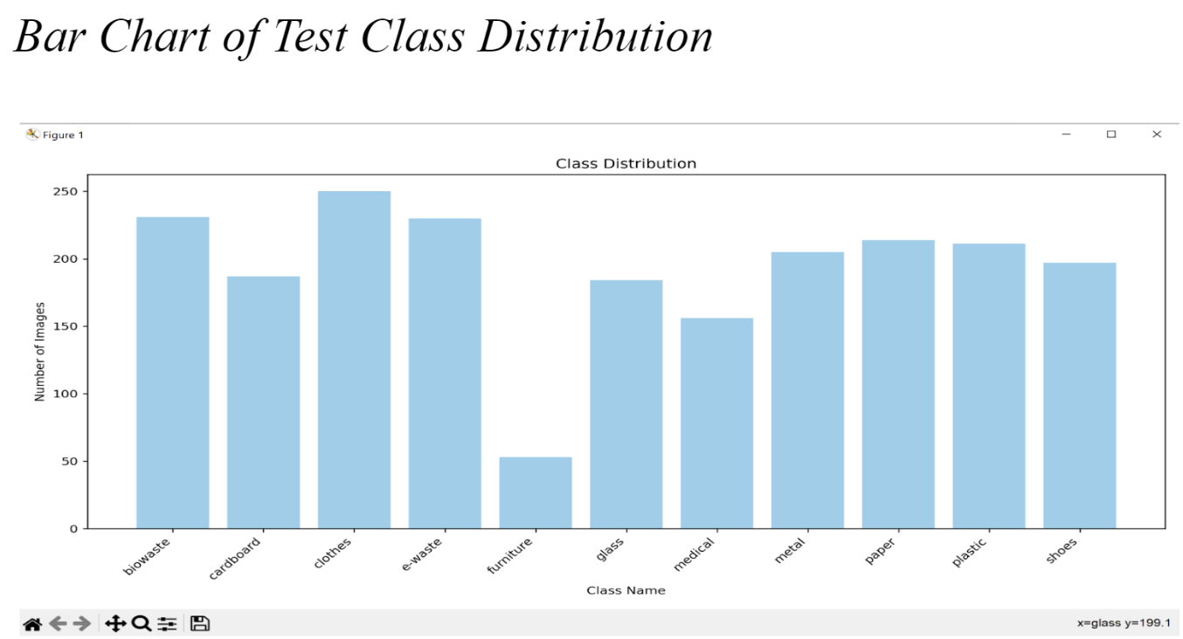

Slide 40
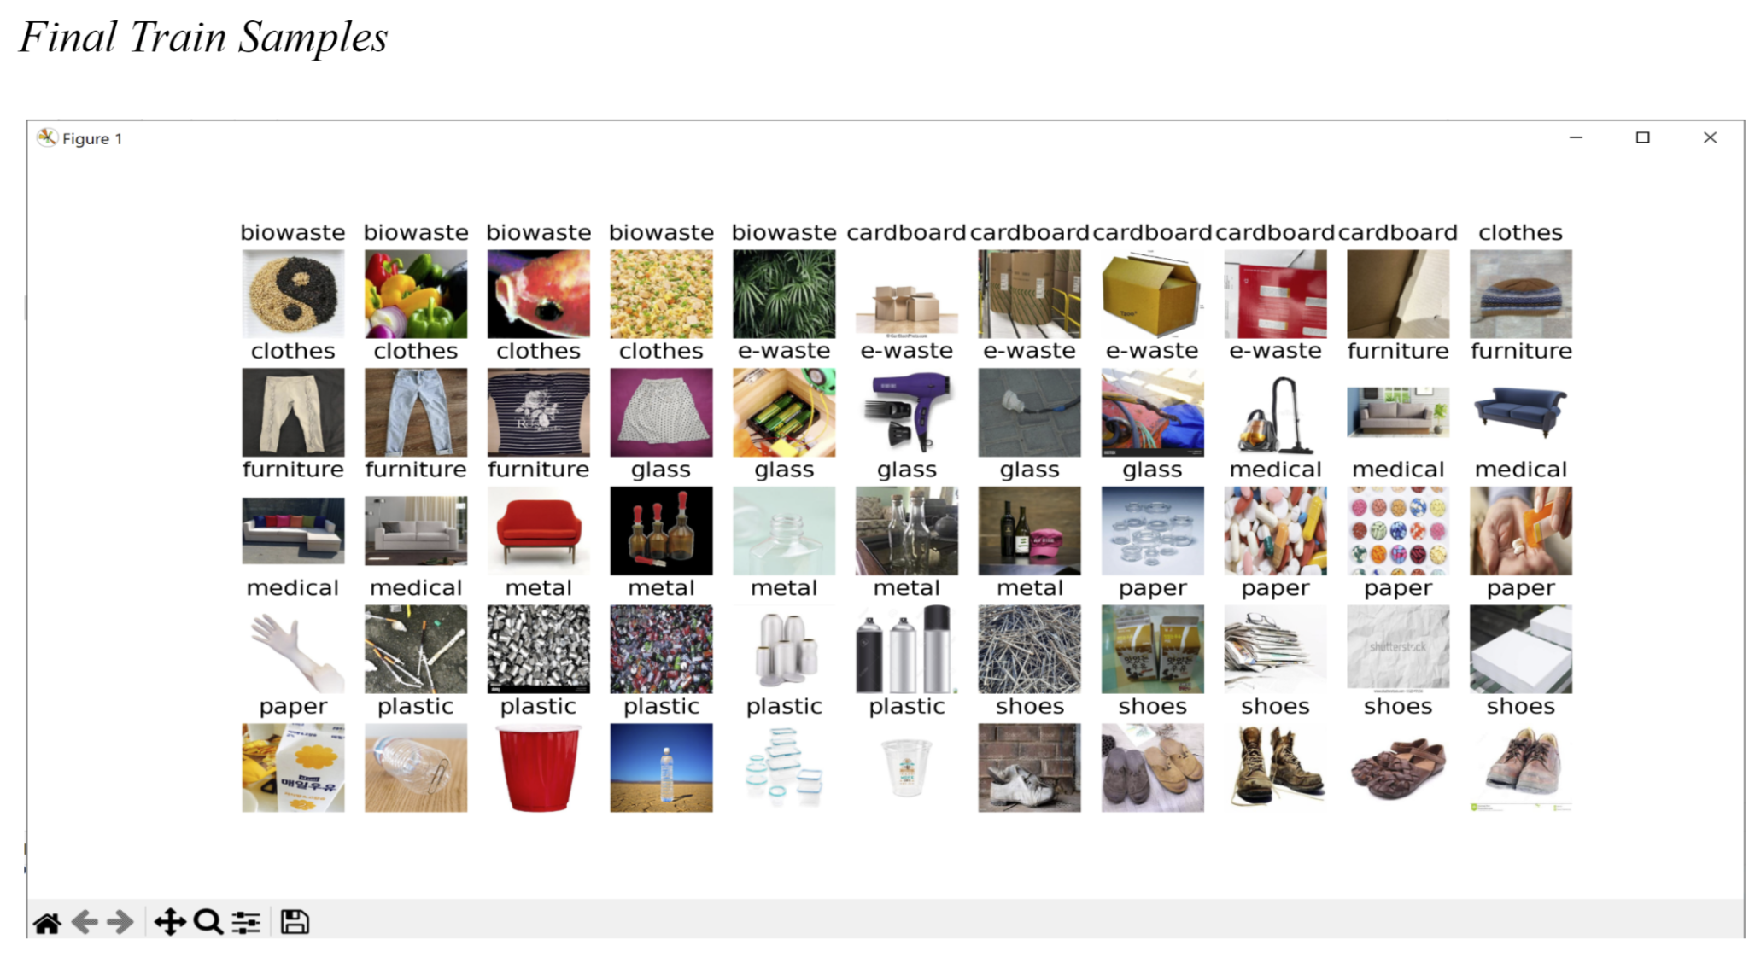

Slide 41
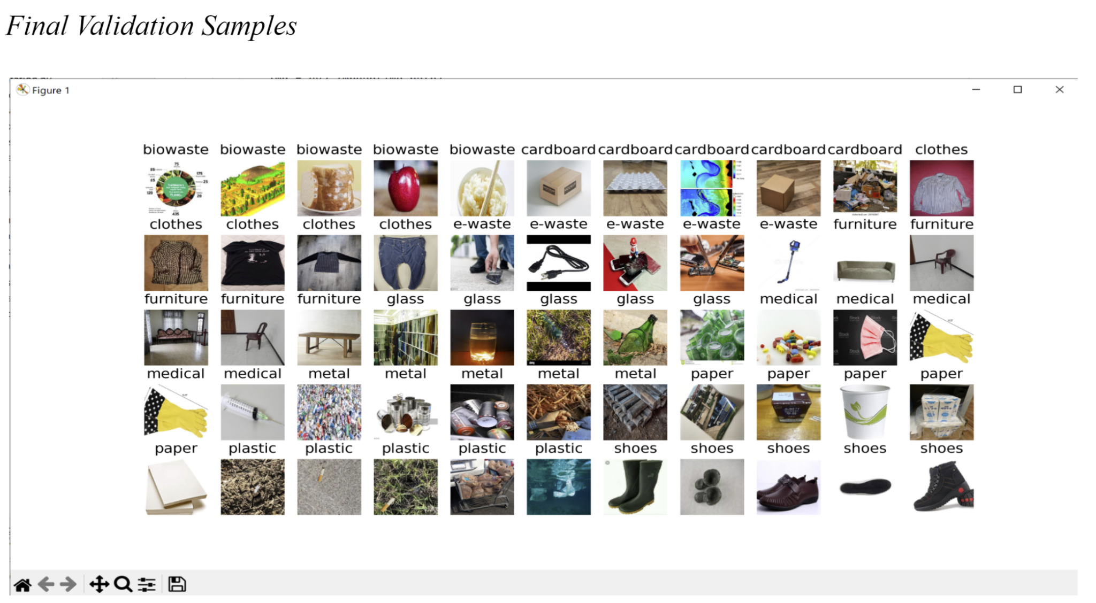

Slide 42
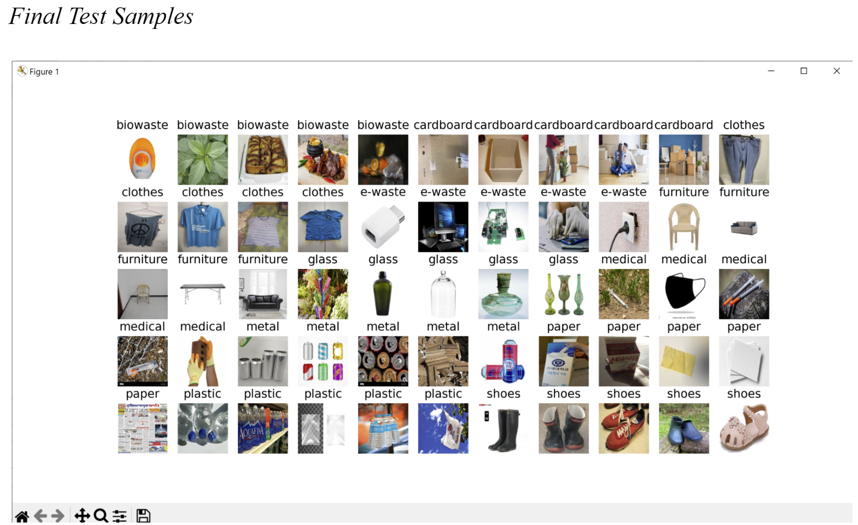

Slide 43
Thanks!

